Slide 1
Soft Robot Actuator
David Camparmo

Slide 2
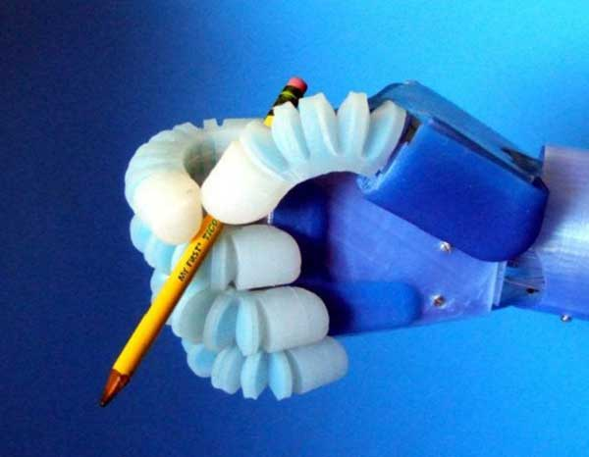
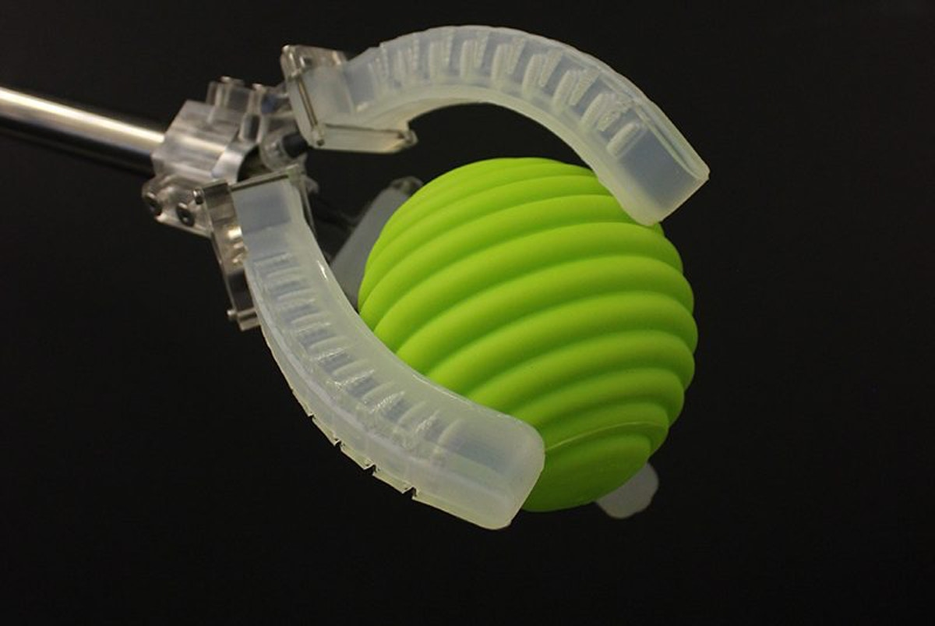
What is it soft robotics?
A sub-field of robotics that constructs components of a robot out of materials that are soft and flexible
Applications
Minimal invasive surgeries
Food industry
Bio-mimicry

Slide 3
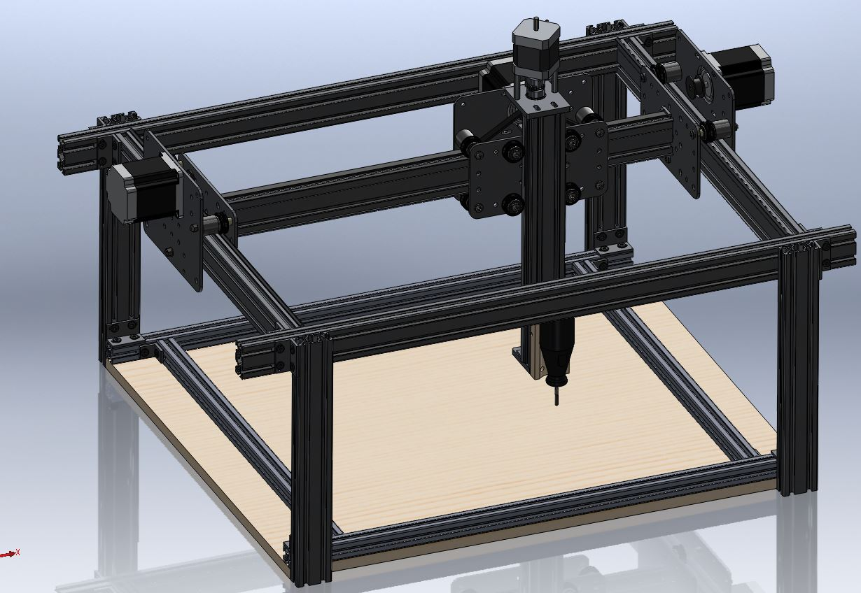
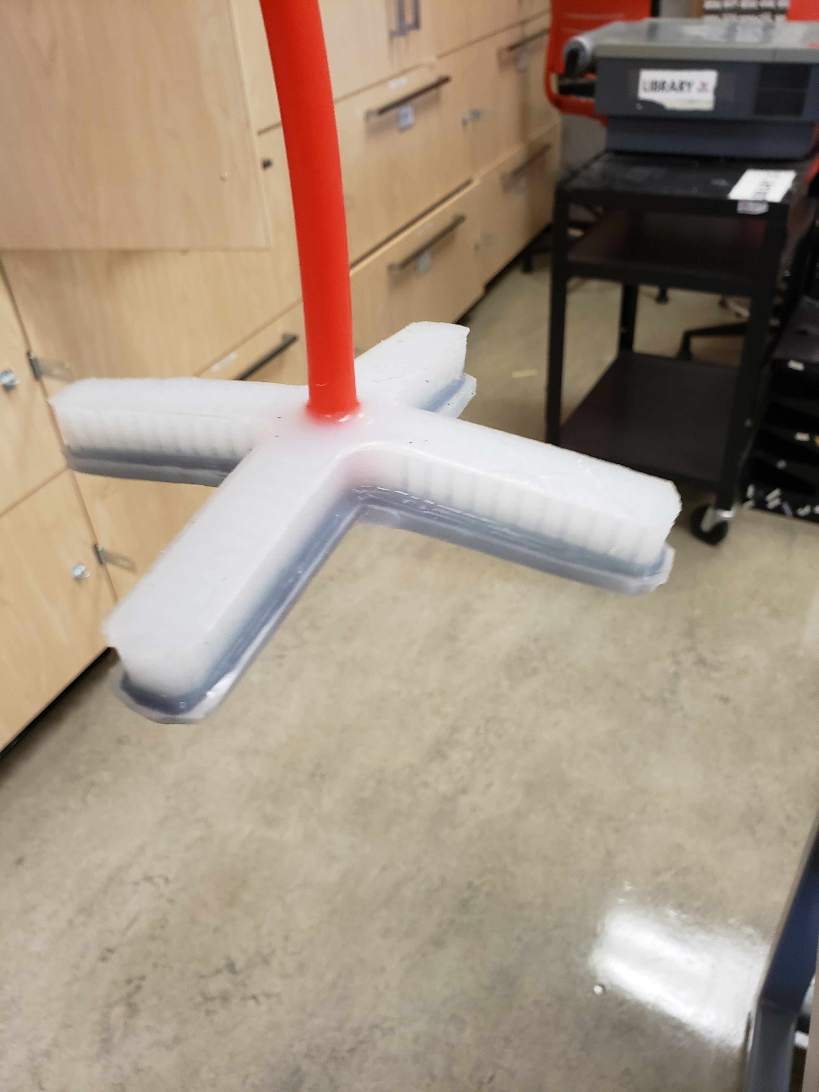
My Project
My goal is to create a Cartesian robot which uses a soft gripping actuator to move objects.

Slide 4
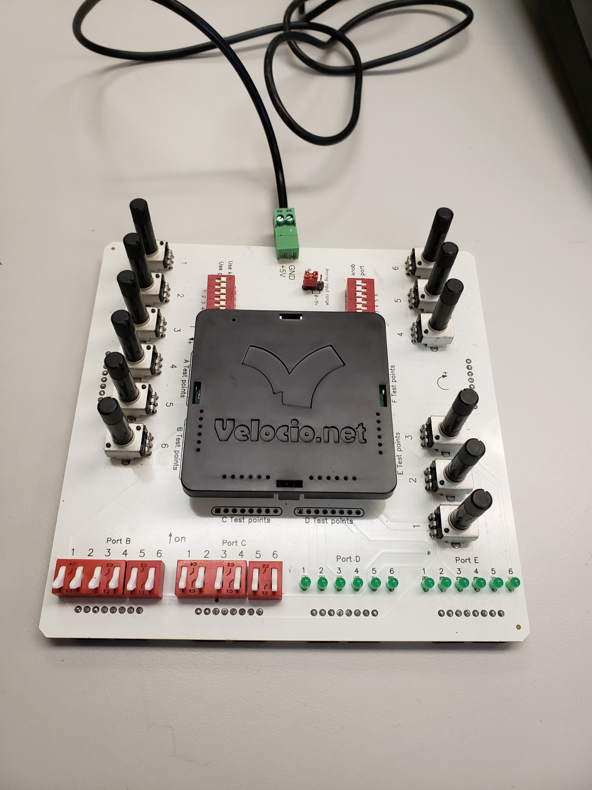
How I will complete the Project
Vbuilder will be used to program a PLC that will send instructions to a stepper motor driver which tells the stepper motors on robot to how to move

Slide 5
Objectives
Build the mechanical system
Build the electrical system that controls the stepper motors with the PLC
Create a user interface

Slide 6
Thank You

